Slide 1

CSE205
Data Structures And Algorithms
Lecture #2
Basic Concepts and Notations
By: Mohammad Shabaz

Slide 2
Asymptotic Notations
Asymptotic notations are the mathematical notations used to describe the running time of an algorithm when the input tends towards a particular value or a limiting value.
For example: In bubble sort, when the input array is already sorted, the time taken by the algorithm is linear i.e. the best case.
But, when the input array is in reverse condition, the algorithm takes the maximum time (quadratic) to sort the elements i.e. the worst case.
When the input array is neither sorted nor in reverse order, then it takes average time. These durations are denoted using asymptotic notations.

Slide 3
Types of Asymptotic Notations
There are mainly three asymptotic notations:
Big-O Notation (O-notation)
Omega Notation (Ω-notation)
Theta Notation (Θ-notation)

Slide 4
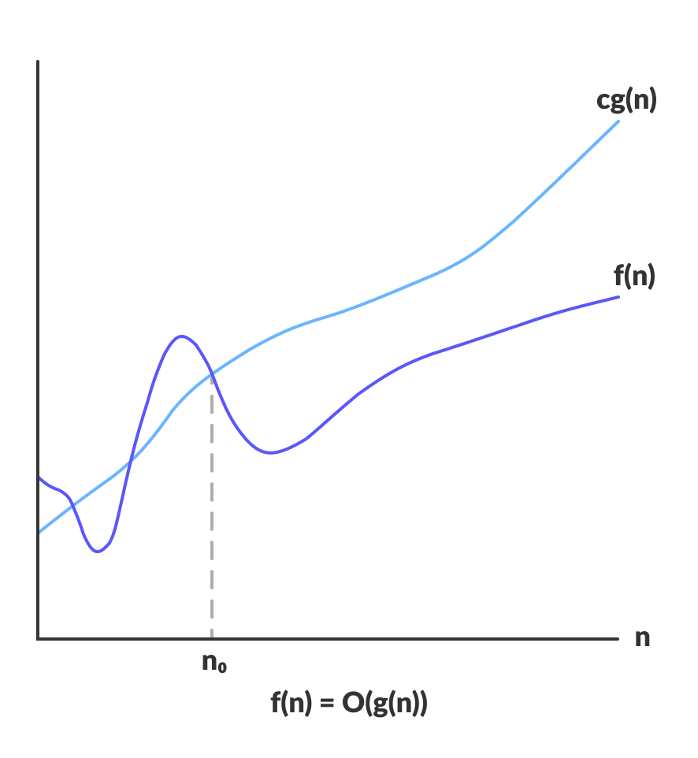
Big-O Notation (O-notation)
Big-O notation represents the upper bound of the running time of an algorithm.
O(g(n)) = { f(n): there exist positive constants c and n₀
such that 0 ≤ f(n) ≤ cg(n) for all n ≥ n₀ }

Slide 5
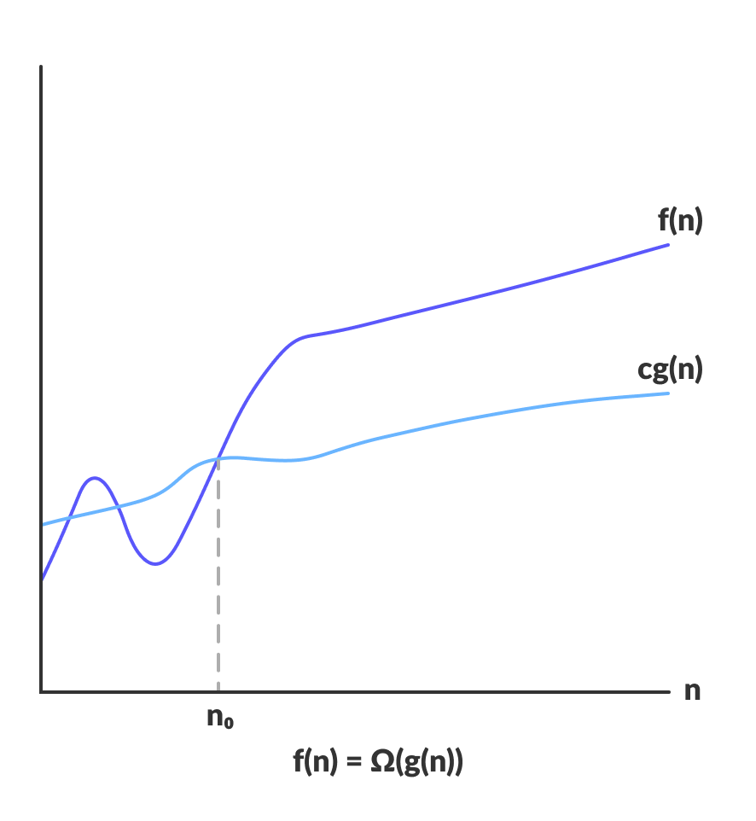
Omega Notation (Ω-notation)
Omega notation represents the lower bound of the running time of an algorithm.
Ω(g(n)) = { f(n): there exist positive constants c and n₀
such that 0 ≤ cg(n) ≤ f(n) for all n ≥ n₀ }

Slide 6
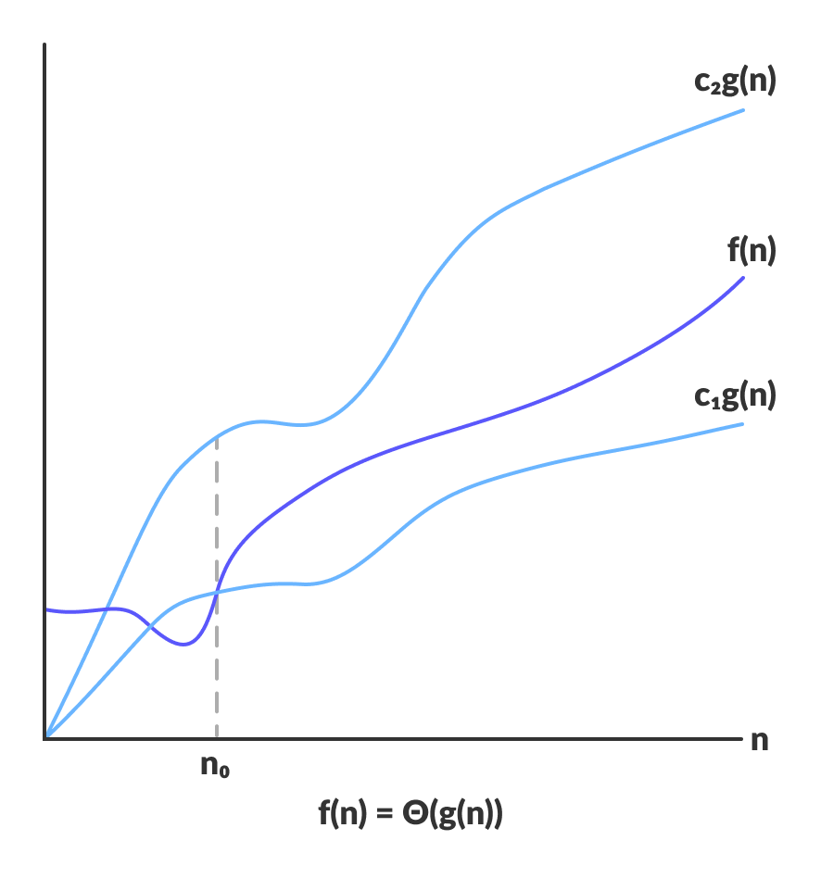
Theta Notation (Θ-notation)
Theta notation encloses the function from above and below. Since it represents the upper and the lower bound of the running time of an algorithm.
Θ(g(n)) = { f(n): there exist positive constants c₁, c₂ and n₀
such that 0 ≤ c₁g(n) ≤ f(n) ≤ c₂g(n) for all n ≥ n₀ }

Slide 7
Time Space Tradeoff
Think of space efficiency and time efficiency as two opposite ends on a band (a continuum). Every point in between the two ends has a certain time and space efficiency. The more time efficiency you have, the less space efficiency you have, and vice versa. The picture below illustrates this in a simple fashion:
Algorithms like Merge sort are exceedingly fast, but require lots of space to do the operations. On the other side of the spectrum, Bubble Sort is exceedingly slow, but takes up the minimum of space.

Slide 8
Example’s
Q1. Suppose You have f(n)=2n+3. Represent it in Big-oh notation.
Ans: we know that, for Big-oh notation,
f(n) ≤ cg(n)
2n+3 ≤ 3n (where 3 is c and n is g(n));
Now, f(n)=Og(n)=O(n).
Q2. Suppose You have f(n)=2n+3. Represent it in Theta notation.
Ans: we know that, for Theta notation,
c₁g(n) ≤ f(n) ≤ c₂g(n)
2n ≤ 2n+3 ≤ 3n (where 2 is c₁ 3 is c₂ and n is g(n));
Now, f(n)= Θg(n)= Θ(n).

Slide 9
Some Quick MCQs

Slide 10
a) θ (n^2) b) θ (n) c) θ (n^3) d) None of the above
1. For the function f (n) =7n + 5. Find out the order of this function in Big theta notation?

Slide 11
a) θ (n^2) b) θ (n) c) θ (n^3) d) None of the above
1. For the function f (n) =7n + 5. Find out the order of this function in Big theta notation?

Slide 12
a) Ω (n^2) b) Ω (n) c) Ω (n^3) d) Ω (2n)
2. For the function f(n) =n^3 + 5n. Find out the order of this function in omega notation?

Slide 13
a) Ω (n^2) b) Ω (n) c) Ω (n^3) d) Ω (2n)
Explanation: cg(n) ≤ f(n) i.e n^3 ≤ n^3 +5n which means, f(n)= Ω (g(n)) = Ω (n^3).
2. For the function f(n) =n^3 + 5n. Find out the order of this function in omega notation?

